Slide 1
Manulife Japan
SPI Portal - Base Architecture

Slide 2
Agenda
Key Requirements
Solution Architecture
Solution Options
Proposed Solution
Technology Stack
Solution Approach

Slide 3

Key Requirements

Slide 4
Business and Functional Requirements
Customer Centric business functions and processes
Packaged product offerings in place of individual products
Enhanced User Experience
Consistent Look and Feel across channels
Personalized and customized content delivery for partners and individuals
Mobile Enablement – Multi Devices
Support Offline Mode
Phased Rollout for Retail and Corporate business
Self Service capabilities

Slide 5
Technical Requirements
Re-use existing Assets (Software / Hardware / User base)
Code once , Use anywhere - any browser, any device
Address browser compatibility related pain points in the current system
Service Enablement of Business Processes
Resolve Performance related pain points
Ease of maintenance

Slide 6
Solution Architecture

Slide 7






Conceptual Model
HTTP calls to refresh pages and access new pages
Manulife Portal
Core Business Services
AGW
Firewall
http
Markup
AGW Services
Data Access
Agent Web Data
Multiple Browsers
and
Devices
AJAX
JSON Data
Other Services
Data Access
Other Apps
Other DB
AJAX calls to refresh content / data
Authentication / Authorization
Core Business functions exposed as services independent of the consuming System / Application, behind domain firewall
No affinity to portal
Federated User Repository
Re-use the existing user repositories by adapting it to the Portal Federation
Agent Web User Repository
Manu Touch LDAP
Other App User Repository

Slide 8


WAS
SPI Portal
CPS
Customer Management
User/Role Data
RBAC
Plan Creation
Granular Access Control
Application Creation
Security Services
User / Role - Mapping
Federated User Repository
TDI
Authentication
TDS
M_USER
M_ROLE
Synchronization

Slide 9
OSCS - Integration
SOAP/HTTP
SOAP/HTTP
SOAP/HTTP
OSCS
ESB
SPI
WODM
1
App Data Acquisition
1
App Data Acquisition
JSON
REST
1
Pre Validation
2
Data Lock
2
Data Lock
JSON
REST
3
Premium Calculation
3
Premium Calculation
JSON
REST
2
Post Validation
4
Data Unlock
4
Data Unlock
JSON
REST

Slide 10
Solution Options

Slide 11
Solution Options
Manulife Portal
Server Centric - Portal
Client Side Rendering
Server Side Rendering
Client Centric – Standard WEB
Single Page Client WEB

Slide 12
Client Side Rendering (Portal)
1
HTML 5 Browser
Portal
HTML
Phase 1
3
User
2
4
Core Business Services
JSON
Data Phase 2
6
Spring
View
Spring
Controller
Model
Local Store
5
1
User navigates to the page containing the portlet.
The view rendering involves 2 phases
Phase 1 (HTML View):
The Portlet controller’s render method dispatches the request to appropriate view.
The view returned contains the standard UI controls that appear in the Header and Footer sections and the place holder for the content.
The scripts (JS Libraries) to call the services asynchronously are also send as a part of the view.
Phase 2 (JSON Data):
The Script code in the browser will now make an asynchronous call to fetch the data.
The ResourceMapping method of the Portlet Controller receives the request and fetches the data from the appropriate Service.
The Json Data is dispatched to the browser
The Callback mechanism of the scripts gets notified of the arrival of data, It will persist the data temporarily to HTML 5 local store.
The data is then shown in the UI place holders .
2
3
4
5
6

Slide 13
Pros & Cons - Client Side Rendering (Portal)
Pros | Cons
The solution will provide better user experience | Requires HTML 5 enabled browser to leverage local storage
Subsequent rendering of the screens will be faster | Mechanisms to refresh the local store will have to be built to ensure changes are reflected in the client side
Optimal use of network bandwidth | Client heavy may require more hardware resources in the client side
More oriented towards the evolution to Offline mode and mobile enablement | Learning curve for developers may affect productivity
Can leverage Portal features and Out of Box Portlets | Portal may become an overkill if the Customization / Personalization requirements are limited
Look and Feel customizations can be easy through themes | First time rendering of the pages may be slow
SSO and Re-use of user repository is supported inherently

Slide 14
Server Side Rendering (Portal)
1
Browser
Portal
HTML
Phase 1
3
4
Core Business Services
User
2
JSON
Data Phase 2
Spring
View
Spring
Controller
Model
5
1
User navigates to the page containing the portlet.
The view rendering involves 2 phases
Phase 1 (HTML View):
The Portlet controller’s render method dispatches the request to appropriate view.
The view returned contains the standard UI controls that appear in the Header and Footer sections and the place holder for the content.
The scripts (JS Libraries) to call the services asynchronously are also send as a part of the view.
Phase 2 (JSON Data):
The Script code in the browser will now make an asynchronous call to fetch the data.
The ResourceMapping method of the Portlet Controller receives the request and fetches the data from the appropriate Service.
The Json Data is dispatched to the browser
The Callback mechanism of the scripts gets notified of the arrival of data
The data is then rendered in the place holders.
2
3
4
5

Slide 15
Pros & Cons - Server Side Rendering (Portal)
Pros | Cons
The entire navigation/presentation logic is governed by the Portal in the server side | Frequent page refreshes may affect user experience
Support for older browsers (Does not require HTML 5) | Network bandwidth usage is not optimal
Can leverage Portal features and Out of Box Portlets | May not be leveraging modern browser features
Look and Feel customizations can be easy through themes | Portal may become an overkill if the Customization / Personalization requirements are limited
SSO and Re-use of user repository is supported inherently

Slide 16
Single Page Client (WEB) – Client Centric
1
Browser
WEB Server
View (HTML)
HTML
Single Page View
User
3
JSON DOM
2
View Model
5
JSON
Core Business Services
Model (Client)
JSON Data
4
This is a client centric solution with only a Single Page View
This solution does not involve a Portal but a standard Web Container
The User launches the application through a browser URL
The Web Server receives the request and responds with the single page view along with all the necessary JavaScript code for Client Side Rendering
JavaScript manipulates the DOM structure to create the dynamic View
Client makes Asynchronous Requests for JSON Data from the Core Business Services to refresh content in the page

Slide 17
Pros & Cons – Single Page Client (WEB)
Pros | Cons
The entire navigation/presentation logic is governed by the Client Side MVVM Framework | The solution will not be able to address the Personalization / Customization requirements
Very rich user experience | The Out of Box portal / portlet features cannot be exploited
Better utilization of network bandwidth | Learning curve for developers may affect productivity
No latency or overheads due to portal | May not support older browsers
More inclined to mobile enablement and offline access

Slide 18
Proposed Solution

Slide 19
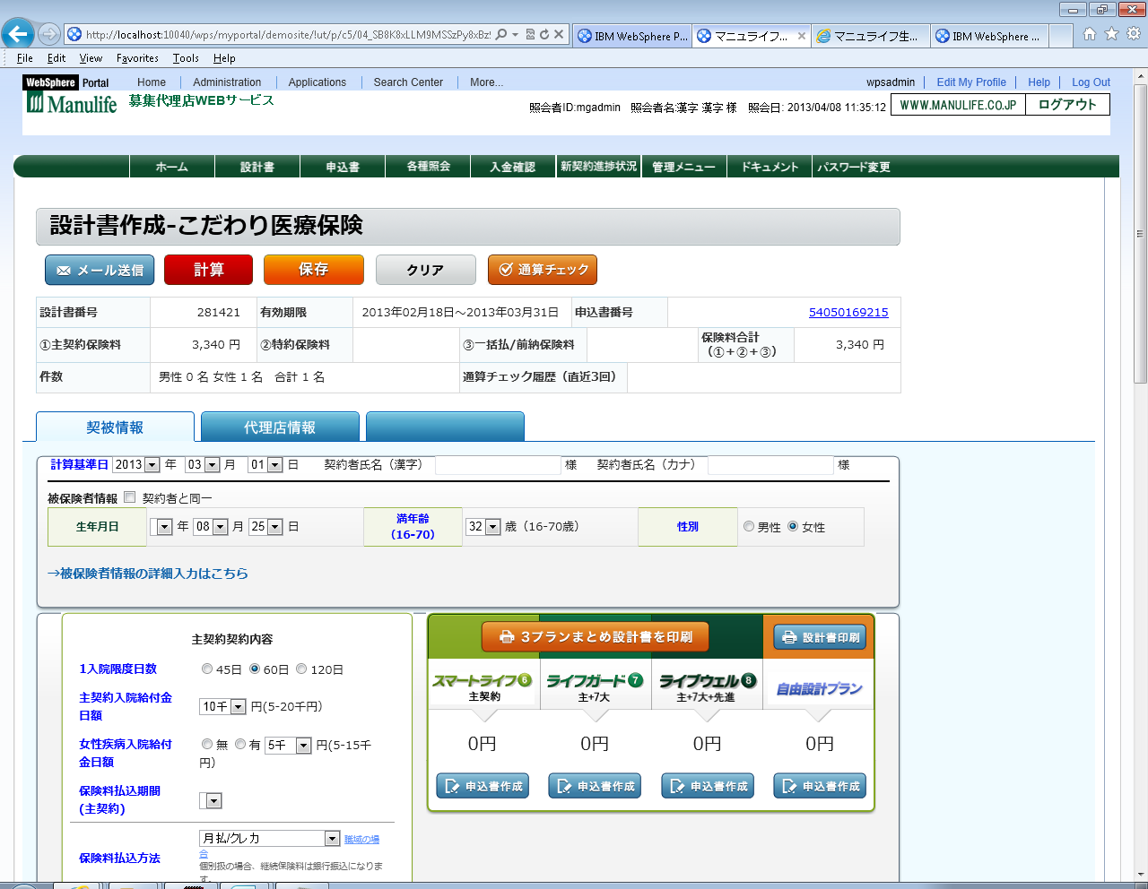


Proposed Solution Architecture
Front End Layer
Websphere App Server
Websphere App Server
Websphere Portal Server
Web Front End
ILL Portlets
Custom Login
Spring MVC portlet controller
Business Layer
Data Access Layer (Hibernate)
App Portlets
Print
Business Service Classes
DAO Classes
External Systems
Web Server
Chart Portlet
Banner Ad
KB Portlet
SVF JAR
Tablet
RBAC
Content Mgmt
SVF API
Unisys
Struts Portlet
App DB
Load Balancer
Batch Jobs
Vantage
Smart Phone
Websphere App Server
Websphere App Server
Ingenium
Websphere Portal Server
Web Server
ILL Portlets
Custom Login
Spring MVC portlet controller
Business Layer
Data Access Layer (Hibernate)
App Portlets
Print
Business Service Classes
DAO Classes
Chart Portlet
Banner Ad
SVF JAR
RBAC
Content Mgmt
SVF API
Client Side Rendering (Portlal) is a hybrid solution involving the benefits of both portal and the rich user experience of Client Centric Solution
This solution would allow us to meet most of the Manulife requirements

Slide 20
Spring Portlet MVC
Flexible and light weight
Request oriented web framework
Implements classic MVC pattern
- Model
Information to be presented
Contract between Controller and View
- View
User interface definition
Used to render the model for display
- Controller
Handles the request and assembles the Model
Delegates to service layer for business logic

Slide 21
Typical Flow (Synchronous)
Handler Mapping
Select
Controller
Business
Generate
lookup
Request
Dispatcher
(Portlet)
Return
ModelAndView
DAO
(Hibernate)
Response
Render
lookup
DB
View
Select
View Resolver

Slide 22
Typical Flow (Asynchronous)
Client
Browser
Ajax Request (Restful)
Controller
Business
DAO
(Hibernate)
Json
DB

Slide 23
Spring portlet MVC
Similar to Spring Web MVC
Driven by Dispatcher (Portlet)
Support different View Technologies
– JSP & JSTL, JSF, Velocity, XSLT etc.,
Comply with JSR 168 and 286
Preserves Action and Render phase separation
Special URL & parameter handling
No locale or theme resolution support.
– responsibility of portal/portlet-container
Similar beans in WebApplicationContext, the different Bean Types are:
– Handler Mapping
– Controller
– View Resolver
– Multipart Resolver
– Handler Exception Resolver

Slide 24
portlet.xml - DispatcherPortlet
<portlet>
<portlet-name>sample</portlet-name>
<portletclass> org.springframework.web.portlet.DispatcherPortlet
</portlet-class>
<supports>
<mime-type>text/html</mime-type>
<portlet-mode>view</portlet-mode>
<portlet-mode>edit</portlet-mode>
<portlet-mode>help</portlet-mode>
</supports>
<portlet-info>
<title>Sample Portlet</title>
</portlet-info>
</portlet>

Slide 25
web.xml – Spring Portlet MVC - View
<web-app>
…
<servlet>
<servlet-name>ViewRendererServlet</servlet-name>
<servletclass>
org.springframework.web.servlet.ViewRendererServlet</
servlet-class>
<load-on-startup>1</load-on-startup>
</servlet>
…
<servlet-mapping>
<servlet-name>ViewRendererServlet</servlet-name>
<url-pattern>/WEB-INF/servlet/view</url-pattern>
</servlet-mapping>
…
</web-app>

Slide 26
Spring Portlet MVC - controller
package sample;
import javax.portlet.RenderRequest;
import javax.portlet.RenderResponse;
import org.springframework.web.portlet.mvc.AbstractController;
import org.springframework.web.portlet.ModelAndView;
public class SampleController extends AbstractController {
public ModelAndView handleRenderRequestInternal(
RenderRequest request,RenderResponse response)
throws Exception {
ModelAndView mav = new ModelAndView(“foo”);
mav.addObject(“message”,”Hello World!”);
return mav;
}
}
<bean id=“sampleController” class=“sample.SampleController”>
<property name=“cacheSeconds” value=“120”/>
</bean>

Slide 27
Spring Portlet MVC Handler Mappings
Using a handler mapping, incoming portlet requests are mapped to appropriate handlers
• Some basic handlers are provided
– PortletModeHandlerMapping
Maps requests based on portlet mode (‘view’, ‘edit’,‘help’,….)
– ParameterHandlerMapping
Uses a specific request parameter to control mapping(default is ‘action’).
– PortletModeParameterHandlerMapping
Combines the previous mappings to allow different navigation within each portlet mode..

Slide 28
Solution Highlights
Multiple Device Support
Cross Browser Compatibility
Responsive UI
Mobile Enablement
Customization / Personalization support for different categories of users and Channels
Single Sign-on support
Re-usability of existing user repository
Maintainability

Slide 29
Technology Stack

Slide 30
Technology Stack
Product / Software | Version
Java2SDK | 1.6
J2EE | 1.6
Log4J | 1.2.15
Spring | 3.0
DB2 | DB2 V9.7.5 Enterprise Server Edition
IBM Http Server | 7.0
WebSphere App Server | 8.0
WebSphere Portal Server | 8.0
Client | Windows XP / Vista with IE 8.0, 9.0, chrome, Mozilla Safari
Acrobat Reader | 6.1 and above
JPA using Hibernate | 4.2.3
jQuery mobile | 1.3.1
HTML | 5
CSS | 3
Angular JS | 1.0.7

Slide 31
Solution Approach

Slide 32
High Level Implementation Tasks
The high level tasks involved in building the SPI portal (Specifically related to Portalizing Agent Web Application) are as listed below.
This is a Bottom-up Approach
DAO Layer Refactoring
BO Layer Service Enabling
Security Integration
Presentation Layer Refactoring

Slide 33
DAO Layer Implementation
DAO Layer implementation involves the following steps
Review the Data Model to understand how it accommodates the new business requirements of packaged product offerings
Create the Entity Model corresponding to the Data Model using JPA tooling provided by RAD / Eclipse
The base entity model provided by the tooling will be a good starting point
It will maintain all associations that are available in the physical tables in the Data Model
Additionally we will have to provide custom finder methods and named queries to enhance it further
The Entity model will evolve again during the Business layer implementation
The Entity Model becomes the basis for out Business Interfaces

Slide 34
Service Enabling Business Layer
Service Enabling the Business Layer implementation involves the following steps
Define a functional model by logically grouping the business functionalities
For each functional component identified, derive fine grained interfaces by providing the well defined input / output structures
The business method should implicitly convey its purpose and should have no affinity to the consuming application.
Provide the implementation of the Business interfaces defined above
Annotation driven approach will be followed to resolve dependencies of service.
The next step is to expose the business interfaces as RESTful web services using webservices annotaions

Slide 35
Security Integration
Security Integration implementation involves the following steps
Custom User Repository Implementation
Authentication Requirement Analysis
Analyze the Agent Web User Registry and Code
Implementing the Custom Repository
Methods for retrieving Entities
Creating new Entities
Deleting Entities
Getting Meta Data
Logging in
Searching for Entities
Updating attributes and membership information
Initializing the repository
Configure the User Repository
Add Custom repository as additional federated repository
Assign administrator role to user in Custom Registry

Slide 36
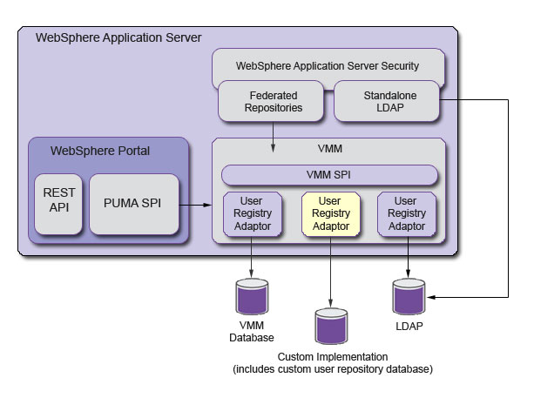
Custom User Repository Implementation
This approach requires us to provide implementation for UserRegistry interface of Service Provider Interface (SPI) provided by IBM
And configure Federated WebSphere Portal to use the Custom User Registry

Slide 37
Presentation Layer Implementation
The recommended Solution is a Hybrid solution involving the benefits of Portal and Single Page Client Application
Review the UI Design provided by the UX team to identify any implementation challenges in the Portal
Modularize the UI functionality in to different Portlets for better maintainability
Design the Portlet
Define the package structure, naming conventions, configuration file locations etc
Implement the presentation layer using Spring MVC portlets (Compliant to JSR 286) with JSP, HTML5, CSS3, AJAX and jQuery/jQuery mobile as UI technologies.
The Spring portlet controller will interact with the business Services exposed as RESTful web services and provide the necessary Model (information) to client tier

Slide 38
Caching
A Caching strategy will have to be formulated to support temporary persistence of intermediate calculations.
The approach has to be less invasive so as not to introduce any additional tool, cost and maintenance overheads.
The functionality provided by Caching mechanism will be equivalent of the functionality supported Temptable in the AS-IS Agent WEB application
Information can be Cached either on the Server or Client
Although Client Side caching may avoid server trip to fetch cached data, it may have implications if the user chooses use a different device
EhCache, an Open Source caching framework is an option for server side caching. Configuring EhCache against a DB can provide long living Cache and features similar to Temptable
EhCache’s feasibility in a clustered environment has to be analyzed
A unique id (Eg: ContractID) can be the key and the value that is cached can be JSON String to avoid further conversions.
We also have to explore IBM provided Caching mechanisms (Eg ObjectGrid)

Slide 39
References

Slide 40
References
SPI_Application_Architecture_Proposal.ppt
Login Options Portal V0.2.pptx
Manulife-AGWPortalSolutionApproach_V1.0.pptx
Mockup_JQueryMobile_20130611
MGA-System Architecture.doc
Manulife - Agent WEB Application Architecture Assessment Report v1.0.docx

Slide 41
Thank You

